Slide 1
INTRODUCTION TO COMPUTING
Course Code: CCINCOM/L
Coding Binary Trees
Joseph Marvin R. Imperial
Faculty
Department of Computer Science
College of Computing and Information Technologies (CCIT)
National University
Joseph Marvin R. Imperial
DATA STRUCTURES AND ALGORITHMS
NU College of Computing and Information Technologies
Course Code: CCDATRCL

Slide 2
Representing the Tree in Java Code
As with other data structures, there are several approaches to representing a tree in the computer’s memory.
The most common is to store / instantiate the nodes at unrelated locations in memory, and connect them using references in each node that point to its children.
As with the other data structures, you normally will need three classes:
The node class for the data
The tree class
The demo class
Joseph Marvin R. Imperial
DATA STRUCTURES AND ALGORITHMS
NU College of Computing and Information Technologies
Course Code: CCDATRCL

Slide 3
Notes on programming binary trees
Similar to linked list, if we want to traverse or go to a node, we need the address / reference of that node.
Example: temp = temp.next;
More bookkeeping since we are maintaining a maximum of two nodes compared to linear data structures.
Joseph Marvin R. Imperial
DATA STRUCTURES AND ALGORITHMS
NU College of Computing and Information Technologies
Course Code: CCDATRCL

Slide 4
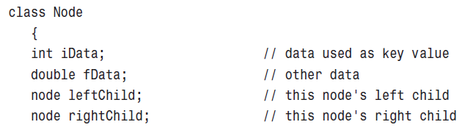
The Node class
First, we need a class of node objects. These objects contain the data representing the objects being stored (employees in an employee database, for example) and also references to each of the node’s two children.
Joseph Marvin R. Imperial
DATA STRUCTURES AND ALGORITHMS
NU College of Computing and Information Technologies
Course Code: CCDATRCL

Slide 5
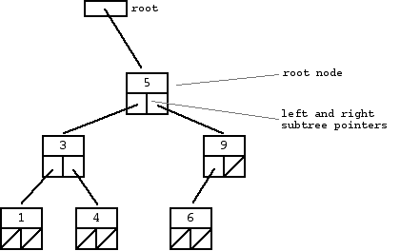

Slide 6
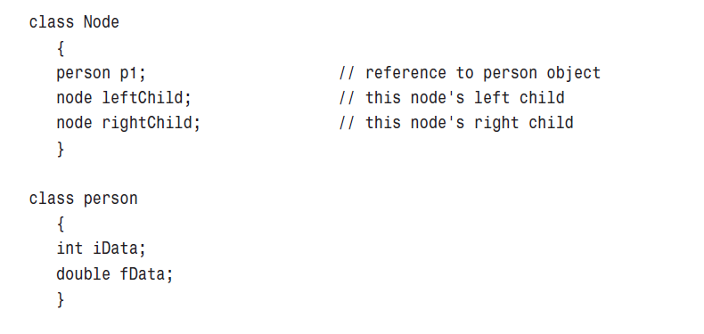
Other approaches
Joseph Marvin R. Imperial
DATA STRUCTURES AND ALGORITHMS
NU College of Computing and Information Technologies
Course Code: CCDATRCL

Slide 7
The Tree class
We’ll also need a class from which to instantiate the tree itself: the object that holds all the nodes. This is the Tree class. It has only one field:
a Node variable that holds the root
It doesn’t need fields for the other nodes because they are all accessed from the root.
The Tree class has a number of methods. They are used for finding, inserting, and deleting nodes (in the case of binary search trees), and the for different kinds of traverses.
Joseph Marvin R. Imperial
DATA STRUCTURES AND ALGORITHMS
NU College of Computing and Information Technologies
Course Code: CCDATRCL

Slide 8
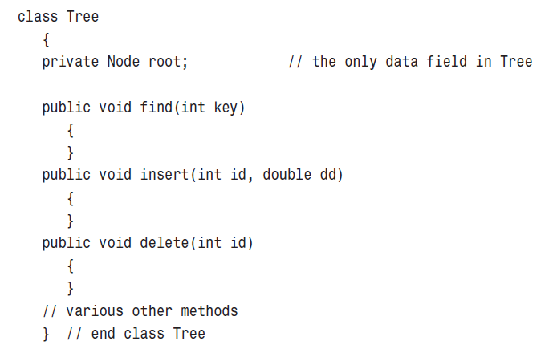
Joseph Marvin R. Imperial
DATA STRUCTURES AND ALGORITHMS
NU College of Computing and Information Technologies
Course Code: CCDATRCL

